Slide 1

Farm Field Security System
Department of computer science ABES Engineering College, Ghaziabad, UP
Project Domain: A.I & ML
Team members:
AUGUTSYA PANDEY
Section: CSE(AI&ML)

Slide 2

Contents
ABSTRACT
INTRODUCTION
LITERATURE SURVEY
METHODLOGY
TOOLS/TECHNOLOGY USED
COST ANALYSIS

Slide 3
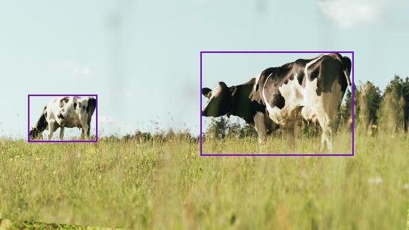
INTRODUCTION
As India is a farming dependent country and farmers suffer a lot of loss due to the intrusion of the animal.
Around 20,000 hectare of crop is damaged in India by the animals and every year it is increasing dramatically .Sometimes conflicts happens between the animal and the humans.
Sometimes farmers use methods like electric fencing which causes harms to wildlife animals.
The objective of the project is to detect the animal in the fields or before entering the fields.
After detecting use of different methods to scare off the animal and sending the real time data of the detected animal to farmer simultaneously.

Slide 4
ABSTRACT
A cost effective system which will monitor the field .
Whenever presence of animal is sensed by the its motion it will trigger to capture the image.
After the image is captured then it will be classified using a Convolutional Neural Network (CNN) and will detect different animal according to the area in which system is implemented .
After the animal is detected the message of presence of animal’s information is sent to the farmer using a gsm module

Slide 5
A GSM module or a GPRS module is a chip or circuit that will be used to establish communication between a mobile device
Both the system will be combined together and will run on a raspberry pi, which will act as a processing unit for the system and predicts the animal.
The whole system will work on solar power

Slide 6
Literature Survey
Using intelligent surveillance to protect crops from animals. Mriganka Gogoi and Savio Raj Philip are the authors. Publication date: November 2015; Journal of Applied and Fundamental Sciences, Volume 1(2) ISSN 2395-5562 The suggested method uses the Fourier transform for segmentation and object identification in order to recognise animals.
A smart farmland with an animal entry detection system and crop prevention Raspberry Pi. S. Santhiya, Y. Dhamodharan, N. E. KaviPriya, and C. S. Santhosh are the authors. International Research Journal of Engineering and Technology (IRJET), Volume: 05, Issue: 03, March 2018. For this, the proposed system makes use of a GSM (Global System for Mobile) modem and an RFID (Radio Frequency Identification Device) module. Farmers and forest officers will receive these SMSes containing the area that the animals watch.
IoT Solutions to Prevent Wild Animal Attacks on Crops Stefano Giordano, Ilias Seitanidis, Mike Ojo, and Davide Adami are the authors. In March 2018, it was published in the IEEE International Conference on Environmental Engineering. They demonstrated how heterogeneous sensors and actuators may coordinate with one another and the cloud to create a platform that would enable the development of new services in this field.

Slide 7
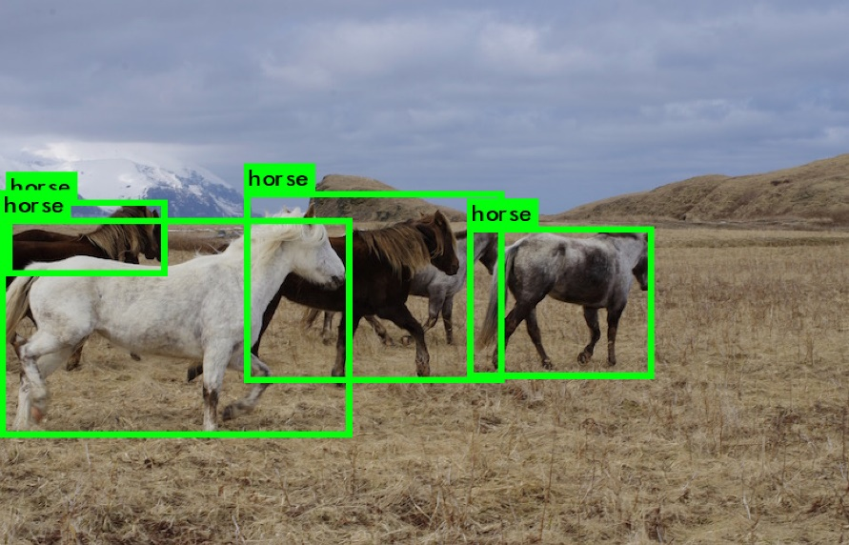




METHODOLOGY
Input :-
:- Along the borders of the farm fields night vision camera, i.e thermal cameras will be mounted on a pole.
:- The sensors have a range of about 30 meters and that of camera is 50 meters.
:- The camera are powered by battery that is connected to a solar panel.
:- Once an animal is detected by the camera from the respective scope of area in which the signal has come from.
:- The camera will then send the image for processing and classification of animal whether it is threat or not.

Slide 8
IMAGE PROCESSING USING CNN :-
The technology used in the image recognition is Convolutional neural network.
A Convolutional Neural Network is a class of artificial neural network, most commonly applied to analyse visual imagery.
CNN can learn multiple layer of feature representation of an Image on applying by using different filters.
The architecture of CNN consists of three types of layer: (1) convolution, (2) pooling, and (3) fully connected.

Slide 9
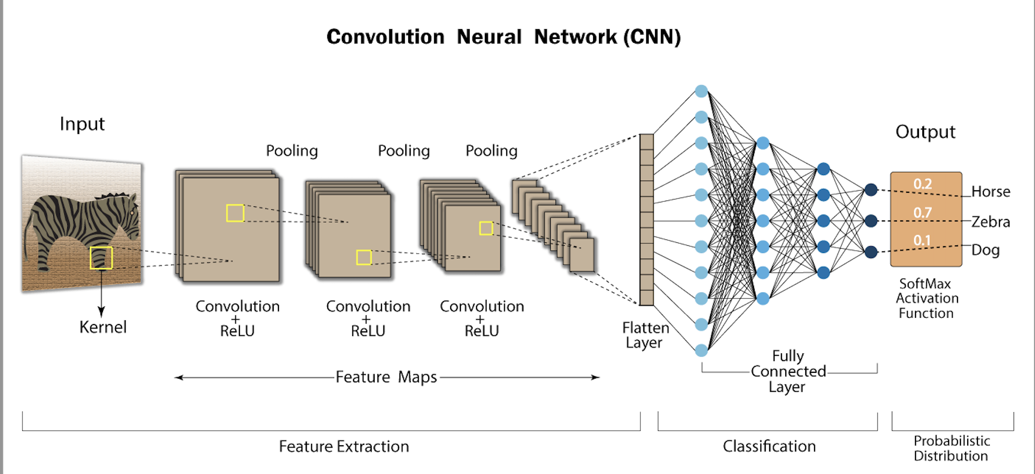

Slide 10
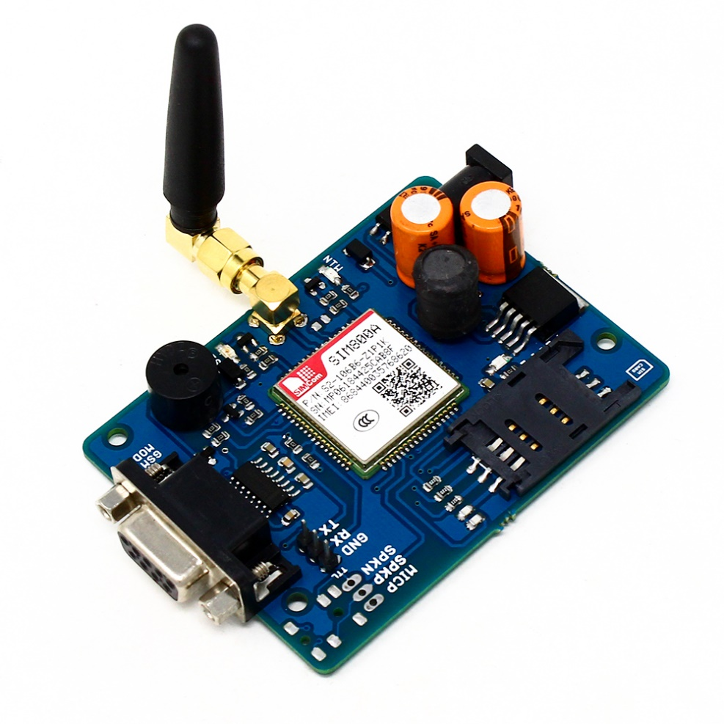
OUTPUT-:
If the animal is detected then the message will be sent to the farmer through gsm module and then scary hooter/repellent system will be activated .
GSM MODULE
A GSM modem or GSM module is a hardware device that uses GSM mobile telephone technology to provide a a data link to a remote network.
Global System for Mobile communication (GSM) is digital cellular system used for mobile devices. It is an international standard for mobile which is widely used for long distance communication.

Slide 11
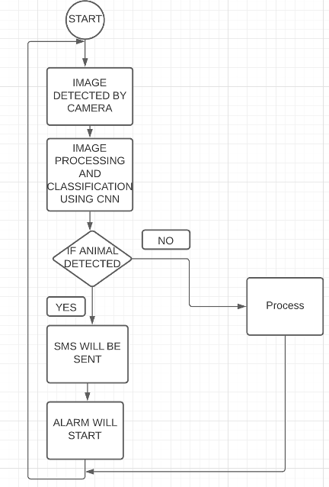
FLOWCHAT OF THE PROJECT

Slide 12
TOOLS AND TECHNOLOGY USED
NIGHT VISION CAMERA
CNN TECHNOLOGY
GSM MODULE
SOLAR PANEL
ANIMAL REPELANT SYSTEM

Slide 13
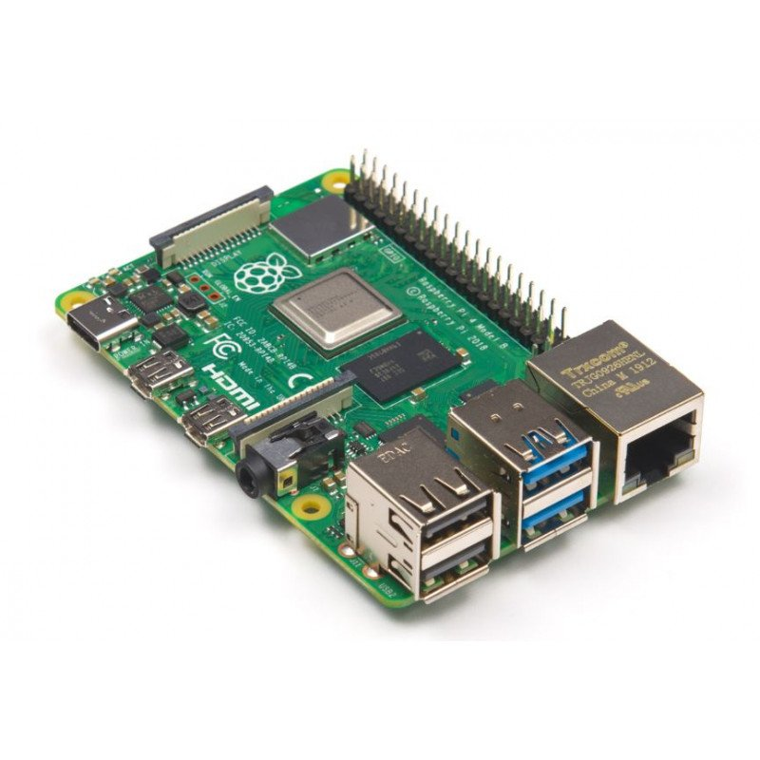
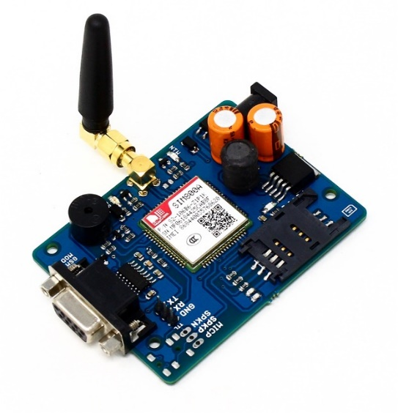
COST ANALYSIS
1-: RASPBERRY PI/ARDUNIO AND GSM MODULE
https://robu.in/product/raspberry-pi-4-model-b-with-2-gb-ram/?gclid=CjwKCAiAlfqOBhAeEiwAYi43F_53Dd0ax5c5LI6jxVGILwIXJEAkMgEfg8Fqq_JbEEUtepKQ7b4ZkRoCSbgQAvD_BwE
https://www.electronicscomp.com/sim900a-gsm-gprs-module-india?gclid=CjwKCAiAlfqOBhAeEiwAYi43F3OC-y6B2LERe5YN8h1buu11GwzXri36ZBrmlB2UQ0pltx-JPojQrhoC2l0QAvD_BwE
+
TOTAL PRICE=4000+1000

Slide 14
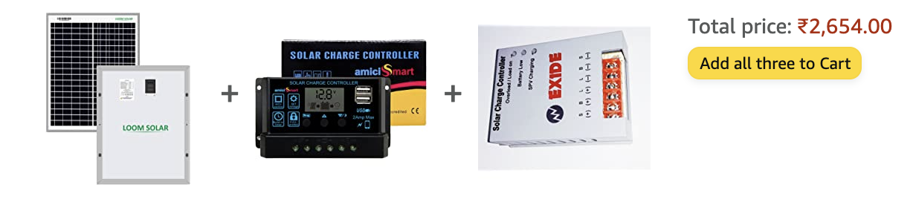
2:-SOLAR PANEL MODULE
(solar panel+controller+battery)
https://www.amazon.in/Loom-Solar-20-Watt-Lighting/dp/B07JVX4PZT/ref=pd_lpo_3?pd_rd_i=B07JVX4PZT&psc=1

Slide 15

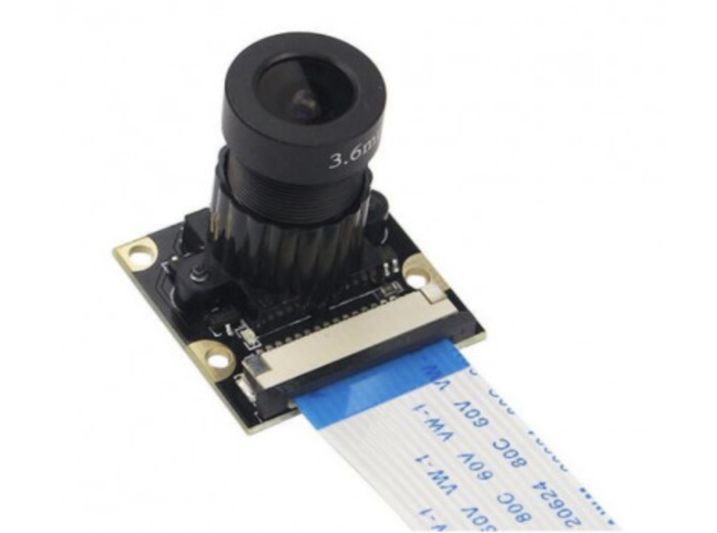
CAMERA AND HOOTERS
https://www.amazon.in/True-Vision-Hooter-Motorcycle-Glamour/dp/B07DYPCS29/ref=sr_1_4?crid=3PTXC2FLH7QC9&keywords=hooters&qid=1642000016&refinements=p_36%3A5814683031&rnid=5814682031&s=automotive&sprefix=%2Cautomotive%2C342&sr=1-4&th=1
https://www.electronicscomp.com/raspberry-pi-infrared-ir-night-vision-surveillance-camera-module-500w-webcam?gclid=CjwKCAiAlfqOBhAeEiwAYi43F2qfeuD5AUpsObdJ1H9L-DchY5I9m2gi2DKaB498y8derDbKU4j9ehoCiC0QAvD_BwE
+
TOTAL PRICE=1200+500

Slide 16
FUTURE SCOPE
CAN BE USED TO PROTECT WILDLIFE ANIMALS FROM POCHERS
CAN BE USED AS SECURITY SURVILLANCE SYSTEM IN RESTRICTED AREAS

Slide 17

THANK YOU

